Slide 1
Digital Patternmaking
Basic Adobe Layout and Tools Used For Pattern Drafting and Design

Slide 2
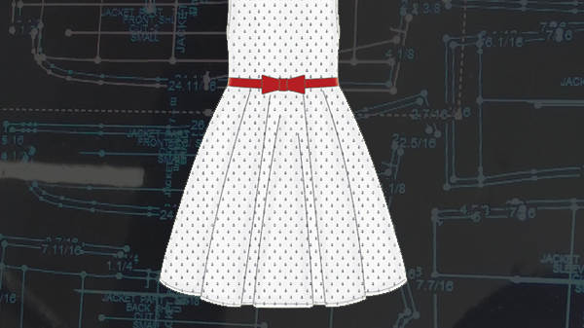
Today’s Class Agenda
Introductions
Instructor Led Review
Instructor Demonstration
Student Practice
Class Lesson Review

Slide 3

Class Introductions
We Really Want To Know Our Customers At Gerber!

Slide 4

Why Illustrator For Patternmaking?
Increase speed and efficiency
Quick transfer of pattern files to sourcing teams and vendors
Easier to communicate and control pattern changes
Go Green-Reduce Waste and Save Money!!!

Slide 5
“Fashion is an instant language.” Miuccia Prada
Artboards
Selection Tool
Direct Selection Tool
Pen Tool
Anchor Points
Convert Anchor Tool
Type Tool
Fill Tool
Stroke Tool
Dash Lines
Object
Path
Offset Path
Adobe Power Words

Slide 6

Questions?
Feel free to ask questions during the lesson and demo. Don’t be afraid to interrupt me or to ask me to repeat any part of the lesson and/or demonstration.
We all have the same goal:
You walk away feeling more confident with using digital software to quickly and efficiently complete your work!

